Slide 1
stdin, stdout, stderr

Slide 2
Linux is built being able to run instructions from the command line using switches to create the output.
The question of course is how do we make use of that?
One of the ways to make use of this is by using the three special file descriptors - stdin, stdout and stderr.

Slide 3
Table 1.2. Standard Input, Standard Output and Standard Error
Type | Symbol
standard input | 0<
standard output | 1>
standard error | 2>

Slide 4
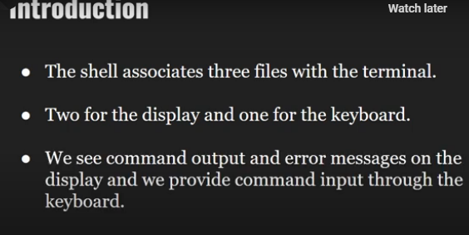

Slide 5
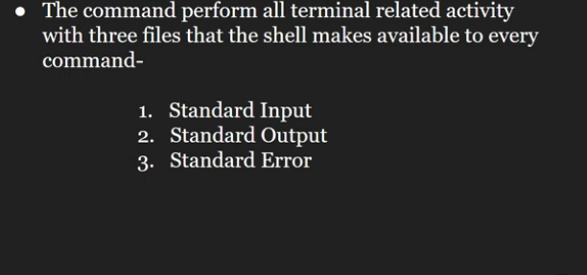

Slide 6
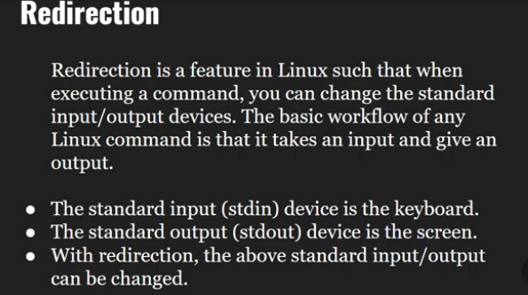

Slide 7
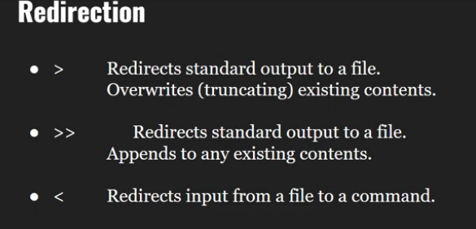

Slide 8
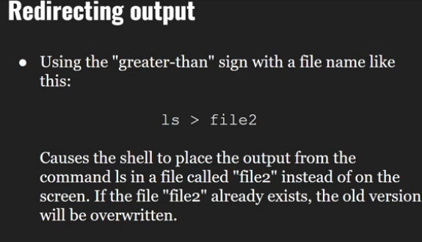

Slide 9
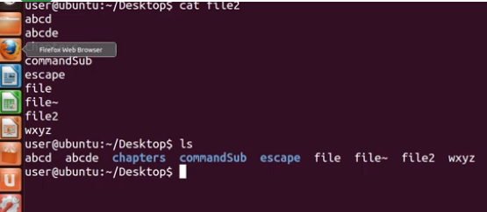

Slide 10
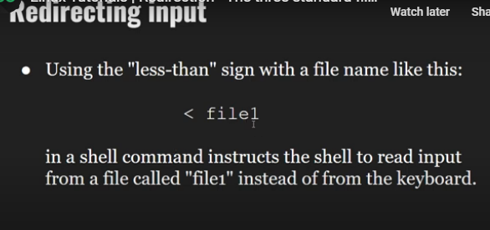

Slide 11
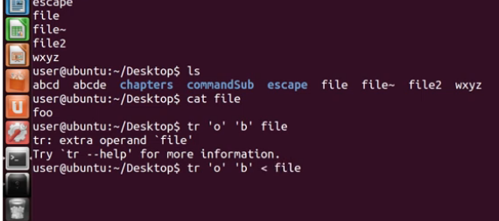

Slide 12
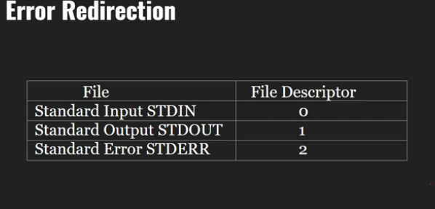

Slide 13
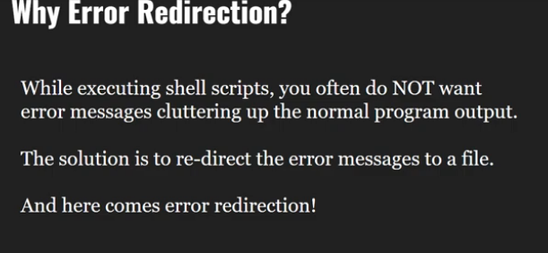

Slide 14
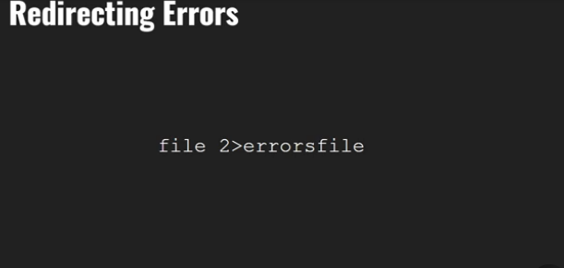

Slide 15
